Slide 1

Copyright © www.ITbodhi.com

Slide 2
Support Vector Machine is one of the most performant off-the-shelf supervised machine learning algorithms.
This means that when you have a problem and you try to run a SVM on it, you will often get pretty good results without many tweaks, because it is based on a strong mathematical background.
Copyright © www.ITbodhi.com

Slide 3
SVMs are the result of the work of several people over many years. The first SVM algorithm is attributed to Vladimir Vapnik in 1963
Copyright © www.ITbodhi.com

Slide 4
SVMs have been successfully used in three main areas:
Text categorization
Image recognition
Bioinformatics
Specific examples include classifying
News stories
Handwritten digit recognition
Cancer tissue samples.
Copyright © www.ITbodhi.com

Slide 5
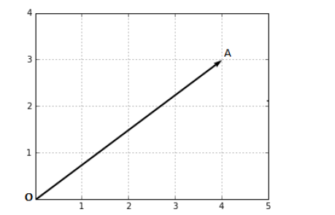
What is a vector?
A vector is a mathematical object that can be represented by an arrow.
Copyright © www.ITbodhi.com

Slide 6
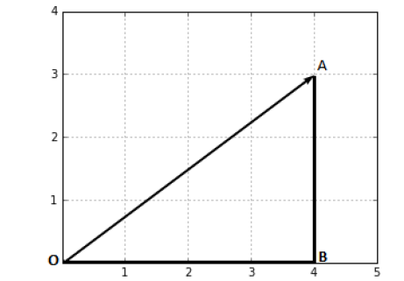
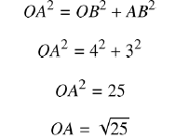
The magnitude of a vector
The magnitude, or length, of a vector is written , and is called its norm.
Copyright © www.ITbodhi.com

Slide 7
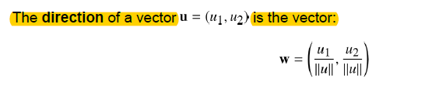
The direction of a vector
The direction is the second component of a vector. By definition, it is a new vector for which the coordinates are the initial coordinates of our vector divided by its norm.
Copyright © www.ITbodhi.com

Slide 8
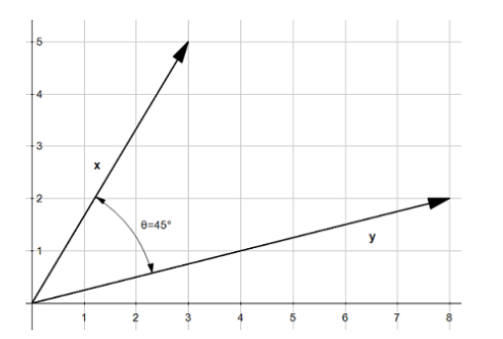
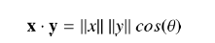
The dot product
The dot product is an operation performed on two vectors that returns a number. A number is sometimes called a scalar; that is why the dot product is also called a scalar product.
Geometric definition of the dot product
Geometrically, the dot product is the product of the Euclidean magnitudes of the two vectors and the cosine of the angle between them.
This means that if we have two vectors, and , with an angle between them their dot product is.
Copyright © www.ITbodhi.com

Slide 9
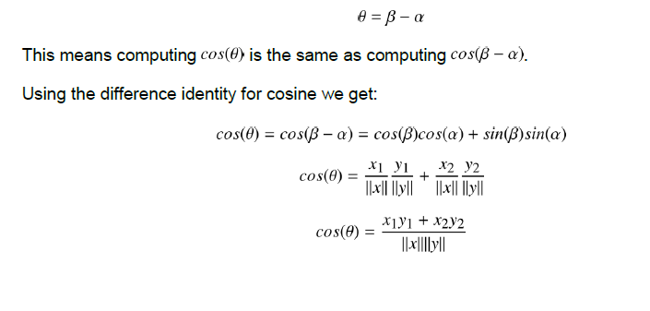
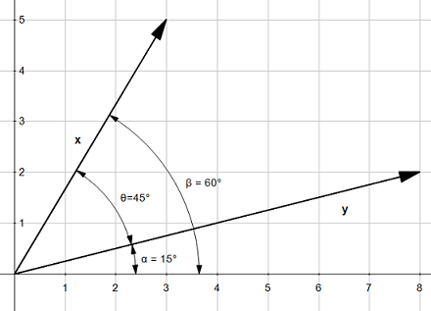
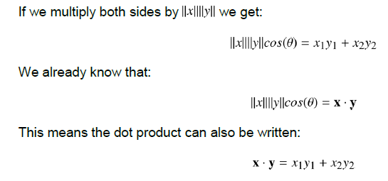
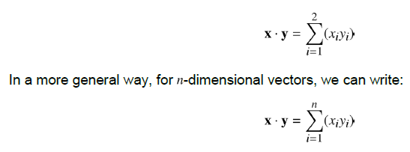
Copyright © www.ITbodhi.com

Slide 10
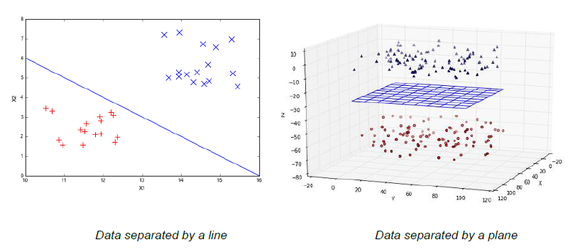
Linearly separable data
Copyright © www.ITbodhi.com

Slide 11
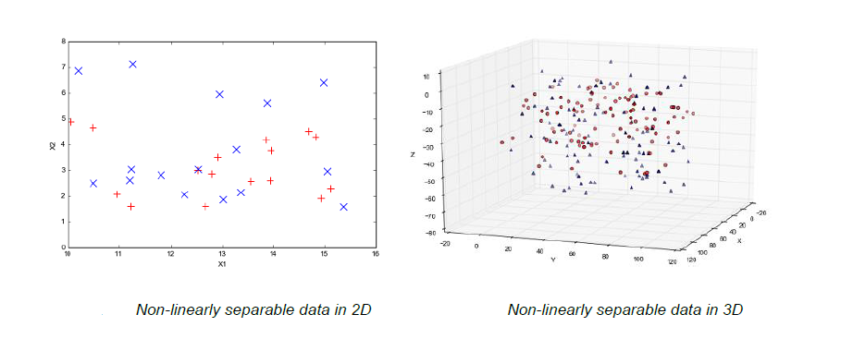
Non-Linearly separable data
Copyright © www.ITbodhi.com

Slide 12
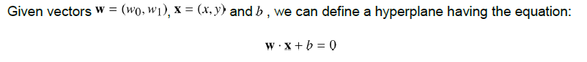
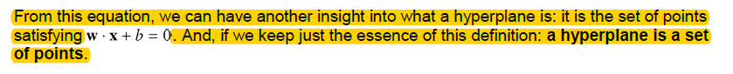
What is a hyperplane?
In geometry, a hyperplane is a subspace of one dimension less than its ambient space.
Copyright © www.ITbodhi.com

Slide 13
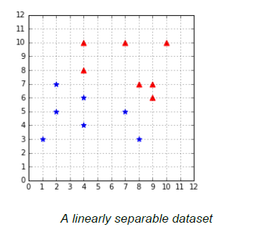
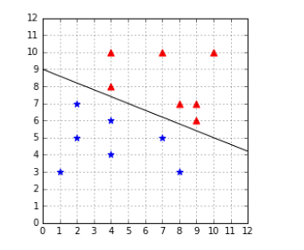
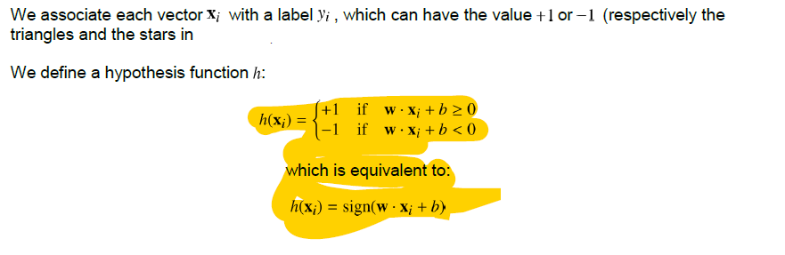
Classifying data with a hyperplane
Copyright © www.ITbodhi.com

Slide 14
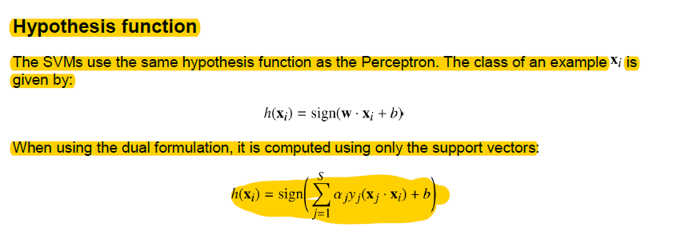
Copyright © www.ITbodhi.com

Slide 15
SVMs search for the optimal hyperplane
Copyright © www.ITbodhi.com

Slide 16
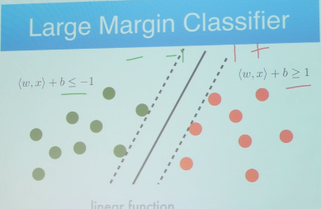
Copyright © www.ITbodhi.com

Slide 17
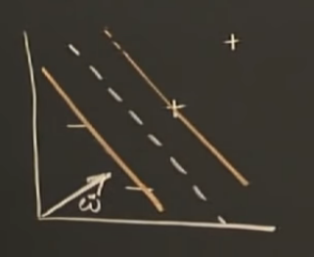
Copyright © www.ITbodhi.com

Slide 18
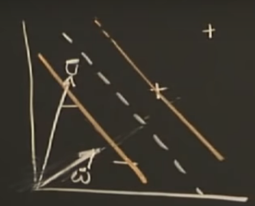
Copyright © www.ITbodhi.com

Slide 19
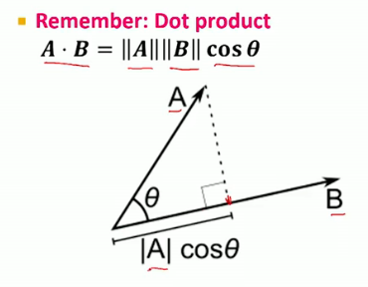
Copyright © www.ITbodhi.com

Slide 20
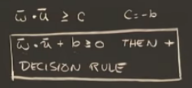
Copyright © www.ITbodhi.com
Notes:
Could be any w and any b

Slide 21
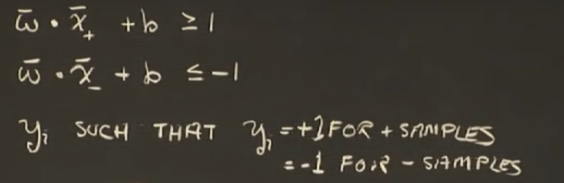
Copyright © www.ITbodhi.com

Slide 22
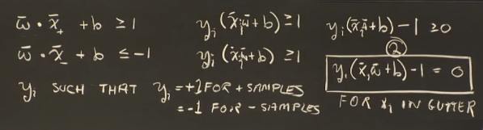
Copyright © www.ITbodhi.com

Slide 23
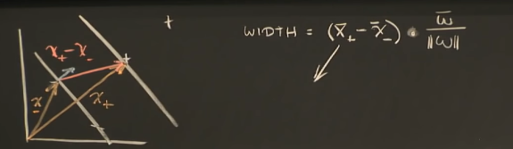
Copyright © www.ITbodhi.com

Slide 24
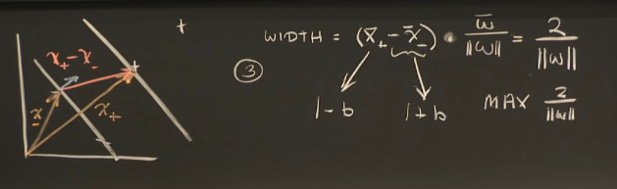
Copyright © www.ITbodhi.com

Slide 25
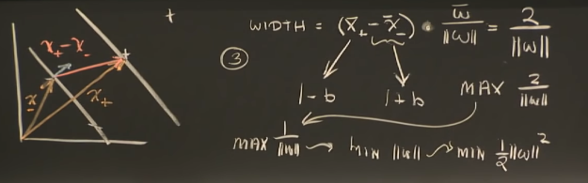
Copyright © www.ITbodhi.com

Slide 26
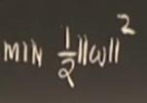
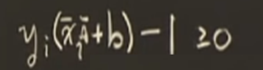
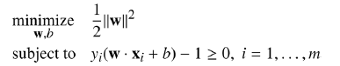
Copyright © www.ITbodhi.com

Slide 27
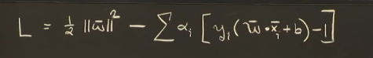
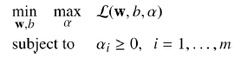
Optimization of a function with given constraints:
Method of Langrage Multipliers will be used to transform the “given function with constraints” to another equivalent “function without constraints” that function and can be optimized (maximize or minimize ).
What is interesting here is that we need to minimize with respect w to b and to maximize with respect to α at the same time.
Copyright © www.ITbodhi.com

Slide 28
It is cost function of SVM with Langrage Multipliers.
Now how to solve it?
The Wolfe dual problem: The Lagrangian problem has m inequality constraints (where m is the number of training examples) and is typically solved using its dual form. The duality principle tells us that an optimization problem can be viewed from two perspectives. The first one is the primal problem, a minimization problem in our case, and the other one is the dual problem, which will be a maximization problem.
Solving the minimization problem involves taking the partial derivatives of with respect to w and b .
Copyright © www.ITbodhi.com

Slide 29
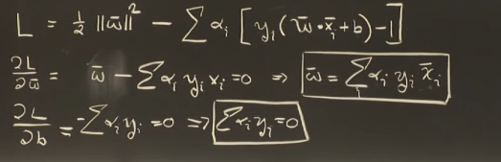
Copyright © www.ITbodhi.com

Slide 30
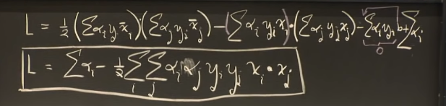
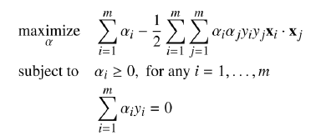
Now aim to find out maximum of above L function.
This is the Wolfe dual Lagrangian function.
The optimization problem is now called the Wolfe dual problem
Copyright © www.ITbodhi.com

Slide 31
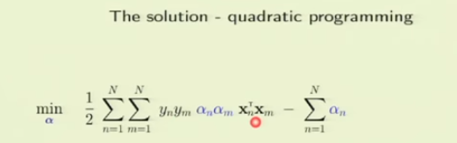
Copyright © www.ITbodhi.com

Slide 32
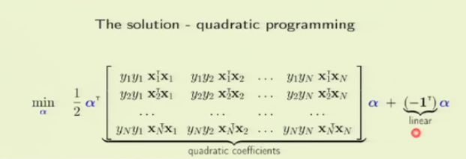
Copyright © www.ITbodhi.com

Slide 33
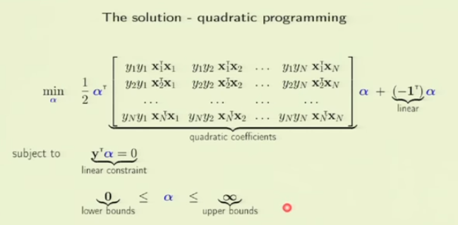
A QP solver is a program used to solve quadratic programming problems.
Python package called CVXOPT
Copyright © www.ITbodhi.com

Slide 34
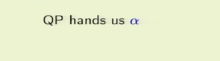
Copyright © www.ITbodhi.com

Slide 35
Karush-Kuhn-Tucker Condition:
Method of Lagrange multipliers is used for solving problems with equality constraints, and here we are using them with inequality constraints. This is because the method still works for inequality constraints, provided some additional conditions (the KKT conditions) are met.
if a solution satisfies the KKT conditions, we are guaranteed that it is the optimal solution.
Copyright © www.ITbodhi.com

Slide 36
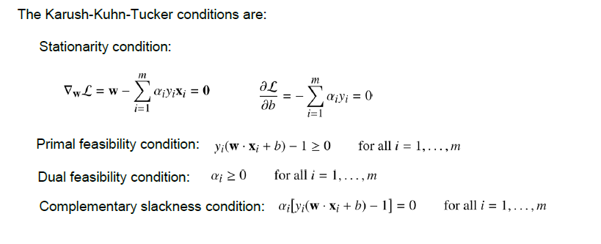
Copyright © www.ITbodhi.com

Slide 37
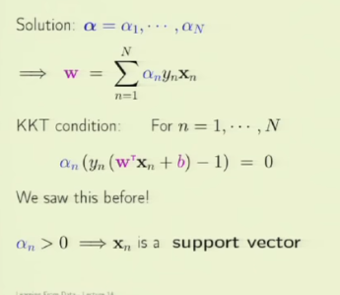
Karush-Kuhn-Tucker Condition: if a solution satisfies the KKT conditions, we are guaranteed that it is the optimal solution
Copyright © www.ITbodhi.com

Slide 38
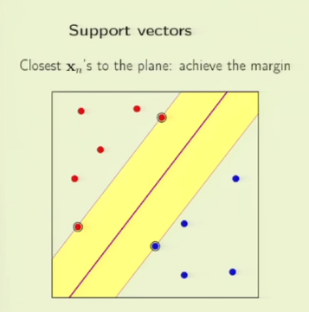
Copyright © www.ITbodhi.com

Slide 39
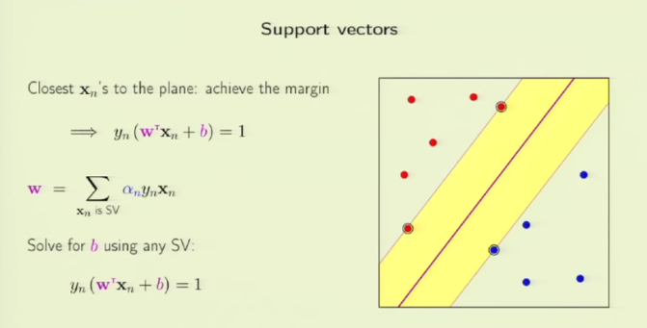
Copyright © www.ITbodhi.com

Slide 40
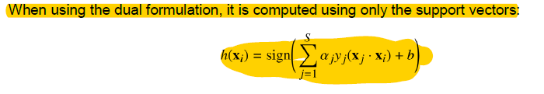
Hypothesis Function After KKT
Copyright © www.ITbodhi.com

Slide 41
Soft Margin SVM
Dealing with noisy data
The biggest issue with hard margin SVM is that it requires the data to be linearly separable. Real-life data is often noisy. Even when the data is linearly separable, a lot of things can happen before you feed it to your model. Maybe someone mistyped a value for an example, or maybe the probe of a sensor returned a crazy value. In the presence of an outlier (a data point that seems to be out of its group), there are two cases: the outlier can be closer to the other examples than most of the examples of its class, thus reducing the margin, or it can be among the other examples and break linear separability.
Copyright © www.ITbodhi.com

Slide 42
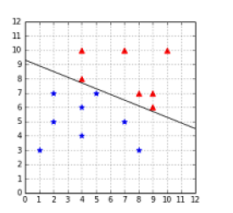
Outlier reducing the margin
When the data is linearly separable, the hard margin classifier does not behave as we would like in the presence of outliers.
In this case, we can see that the margin is very narrow, and it seems that the outlier is the main reason for this change. Intuitively, we can see that this hyperplane might not be the best at separating the data, and that it will probably generalize poorly.
Copyright © www.ITbodhi.com

Slide 43
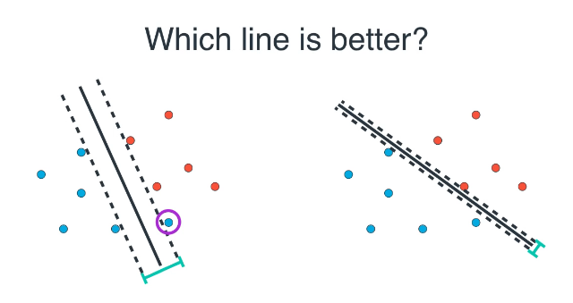

Slide 44
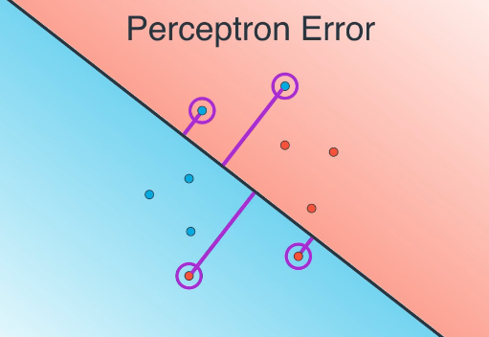

Slide 45
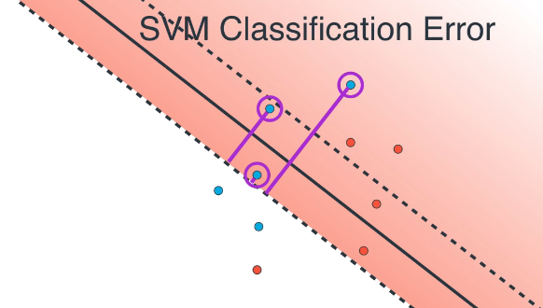

Slide 46
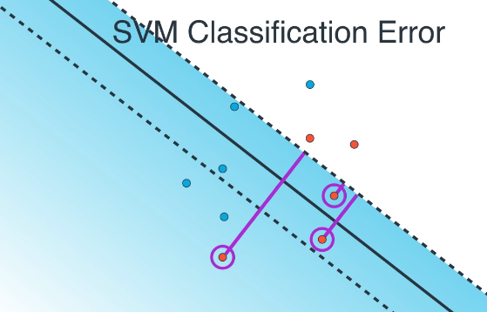

Slide 47


Slide 48


Slide 49


Slide 50


Slide 51


Slide 52


Slide 53


Slide 54

Outlier breaking linear separability
Even worse, when the outlier breaks the linear separability, the classifier is incapable of finding a hyperplane. We are stuck because of a single data point.
Copyright © www.ITbodhi.com

Slide 55

Soft margin to the rescue: Slack variables
The goal is now not to make zero classification mistakes, but to make as few mistakes as possible.
As a result, when minimizing the objective function, it is possible to satisfy the constraint even if the example does not meet the original constraint
Copyright © www.ITbodhi.com

Slide 56

The problem is that we could choose a huge value for every example, and all the constraints will be satisfied.
Copyright © www.ITbodhi.com

Slide 57

Copyright © www.ITbodhi.com

Slide 58

Copyright © www.ITbodhi.com

Slide 59

Copyright © www.ITbodhi.com

Slide 60

Copyright © www.ITbodhi.com

Slide 61
How to find the best C?
There is no magic value for that will work for all the problems. The recommended approach to select is to use grid search with cross-validation
Copyright © www.ITbodhi.com

Slide 62

Copyright © www.ITbodhi.com

Slide 63
Kernels
Feature Transformation
Copyright © www.ITbodhi.com

Slide 64


Can we classify non-linearly separable data?
Imagine you have some data that is not separable and you would like to use SVMs to classify it. We have seen that it is not possible because the data is not linearly separable. However, this last assumption is not correct. What is important to notice here is that the data is not linearly separable in two dimensions.
Copyright © www.ITbodhi.com

Slide 65


If you transform the whole data set of Last Figure and plot the result after transformation, you get below Figure, which does not show much improvement. However, after some time playing with the graph, we can see that the data is, in fact, separable in three dimensions
Copyright © www.ITbodhi.com

Slide 66
Here is a basic recipe we can use to classify this dataset:
1. Transform every two-dimensional vector into a three-dimensional vector using the transform method of Code Listing 31.
2. Train the SVMs using the 3D dataset.
3. For each new example we wish to predict, transform it using the transform method before passing it to the predict method.
Of course, you are not forced to transform the data into three dimensions; it could be five, ten, or one hundred dimensions.
How do we know which transformation to apply?
Choosing which transformation to apply depends a lot on your dataset. Being able to transform the data so that the machine learning algorithm you wish to use performs at its best is probably one key factor of success in the machine learning world. Unfortunately, there is no perfect recipe, and it will come with experience via trial and error.
Copyright © www.ITbodhi.com

Slide 67

What is a kernel?
In the last section, we saw a quick recipe to use on the non-separable dataset. One of its main drawbacks is that we must transform every example.
If we have millions or billions of examples and that transform method is complex, that can take a huge amount of time.
This is when kernels come to the rescue.
If you recall, when we search for the KKT multipliers in the Lagrangian function, we do not need the value of a training example ; we only need the value of the dot product between two training examples:
Copyright © www.ITbodhi.com

Slide 68
The question is this:
Is there a way to compute this value, without transforming the vectors?
And the answer is: Yes, with a kernel!
A kernel is a function that returns the result of a dot product performed in another space.
Copyright © www.ITbodhi.com

Slide 69
The vectors x1 and x2 belong to R². The kernel function computes their dot product as if they have been transformed into vectors belonging to R³, and it does that without doing the transformation, and without computing their dot product.
Pretty incredible !!
This is beauty of Mathematics ☺
Copyright © www.ITbodhi.com

Slide 70


If we define a kernel as: , we can then rewrite the soft-margin dual problem:
Applying the kernel trick simply means replacing the dot product of two examples by a kernel function.
Copyright © www.ITbodhi.com

Slide 71

Kernel types
Linear kernel
This is the simplest kernel. It is simply defined by:
In practice, linear kernel works well for text classification.
Copyright © www.ITbodhi.com

Slide 72


Polynomial kernel: It has two parameters which represents a constant term, and , which represents the degree of the kernel.
Copyright © www.ITbodhi.com

Slide 73

Updating the degree
A polynomial kernel with a degree of 1 and no constant is simply the linear kernel.
When you increase the degree of a polynomial kernel, the decision boundary will become more complex and will have a tendency to be influenced by individual data examples. Using a high-degree polynomial is dangerous because you can often achieve better performance on your test set, but it leads to what is called overfitting: the model is too close to the data and does not generalize well.
Copyright © www.ITbodhi.com

Slide 74


RBF or Gaussian kernel
Sometimes polynomial kernels are not sophisticated enough to work. When you have a difficult dataset like the one depicted in Figure.
Earlier kernel will show its limitation in these case.
Copyright © www.ITbodhi.com

Slide 75

It is also named RBF kernel, where RBF stands for Radial Basis Function. A radial basis function is a function whose value depends only on the distance from the origin or from some point.
The RBF kernel function is:
Copyright © www.ITbodhi.com

Slide 76


Using RBF kernel:
The RBF kernel classifies the
data correctly with gamma = 0.1
Changing the value of gamma
When gamma is too small,
the model behaves like a linear SVM.
When gamma is too large, the model
is too heavily influenced by each
support vector.
When gamma is too small, as in Figure 1, the model behaves like a linear SVM. When gamma is too is too large, the model is too heavily influenced by each support vector as shown in figure 2.
Copyright © www.ITbodhi.com

Slide 77
Which kernel should I use?
The recommended approach is to try a RBF kernel first, because it usually works well. However, it is good to try the other types of kernels if you have enough time to do so ☺
The kernel trick is one key component making Support Vector Machines powerful. It allows us to apply SVMs on a wide variety of problems even if data is non-separable.
Copyright © www.ITbodhi.com

Slide 78

Multi-Class Classification
Using SVMs :
Copyright © www.ITbodhi.com

Slide 79

One-against-all
In order to classify K classes, we construct
K different binary classifiers.
For a given class, the positive examples are
all the points in the class, and the negative
examples are all the points not in the class.
We train one binary classifier on each problem
As a result, we obtain one decision boundary
per classifier .
In order to make a new prediction, we use each classifier and predict the class of the classifier if it returns a positive answer
Copyright © www.ITbodhi.com

Slide 80

One-against-one
In this approach, instead of trying to distinguish one class from all the others, we seek to distinguish one class from another one. As a result , we train one classifier per pair of classes, which leads to K(K-1)/2 classifiers for K classes.
Predictions are made using a simple voting strategy. Each example we wish to predict is passed to each classifier, and the predicted class is recorded. Then, the class having the most votes is assigned to the example
Copyright © www.ITbodhi.com

